Slide 1

REMOTELY-CONTROLLED HYDRO VEHICLE FOR WATER SAMPLE COLLECTION AT VARYING WATER LEVELS
Presented by :
Vikram Verma (BTECH/10161/21)
Shambhavi Jha (BTECH/10284/21)
Project guide:
Dr. S.S. Solanki
Electronics and Communication Engineering
BIT Mesra, Ranchi
Department of ECE, BIT, Mesra, Ranchi-835215

Slide 2
OUTLINE
Introduction to the problem statement
Existing methods
Literature Review
Methodology
Approach (Schematic)
Collection Cylinder
Pressure Sensor and NRF Modules
Stepper Motor implementation
Switching of Solenoid Valve
Results and Discussion
Conclusion and future scope
References

Slide 3
INTRODUCTION TO THE PROBLEM STATEMENT
Water sources nowadays are highly polluted.
Water treatment plants are working at capacity to lower the pollutant levels and supply clean water.
If we determine the properties of water at different depths before-hand, efficiency of these plants can be greatly increased.
Different treatment agents will be used in proportion.
Instead of going through all the procedures of water treatment, only those that are necessary in accordance with the properties obtained will be carried out.
Thus arises a need for water collection at different depths.
Various methods exist but we needed a cheaper and quicker alternative.
Making the system remote-controlled significantly reduced the amount of physical labour required during sampling

Slide 4
EXISTING METHODS
Tools | Advantages | Disadvantages
Bottom sampler | Construction is easy. Inexpensive Very portable Readily available | Sampling process is time consuming
Suction-lift Pump | Relatively portable Readily available Inexpensive | Sampling is limited to situations where water levels are within about 20 ft of the ground surface
Air-lift Samplers | Relatively portable Readily available Inexpensive | Causes changes in carbon dioxide concentrations; hence not suitable for sampling pH sensitive parameters.
Gas- operated Pump | Construction is simple Relatively portable | Large gas volumes and long cycles are necessary when pumping from deep wells. Expensive
Submersible Pump | Construction is simple Wide range of diameters Constructed from various materials | Too large and not portable Expensive

Slide 5
LITERATURE REVIEW
Paper title | Objective | Component | Result
Design and Development of Stepper Motor Position Control using Arduino Mega 2560 | Stepper motor control using Arduino | Stepper motor Motor driver | Use of Stepper motor with A4988 driver Use of Arduino Uno
Motion Control with an Arduino: Servo and Stepper Motor Controls | Controlling RPM of stepper motor using Arduino | Arduino coding | Control of Stepper motor using RC
Seawater sampling and collection | Sampling methods | Niskin bottles | Creation of Collection Cylinder
Development of Design of Pneumatic Circuits using Arduino Microcontroller | 12V Solenoid Air-Water Valve Controlling it using Arduino | Arduino coding Pressure considerations | Use of Air-Water valves for water intake

Slide 6
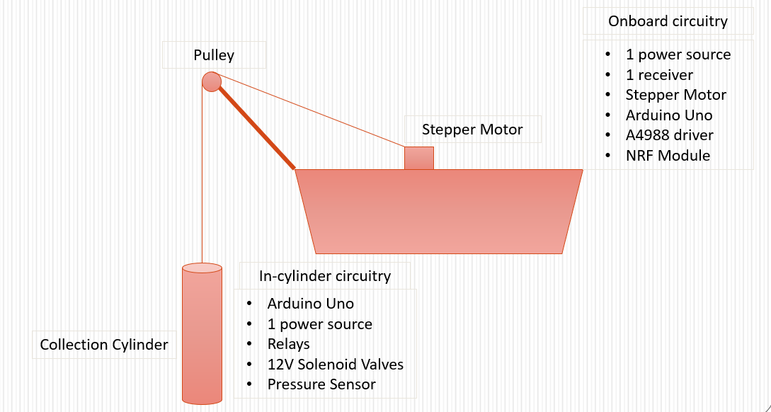
METHODOLOGY (APPROACH)

Slide 7
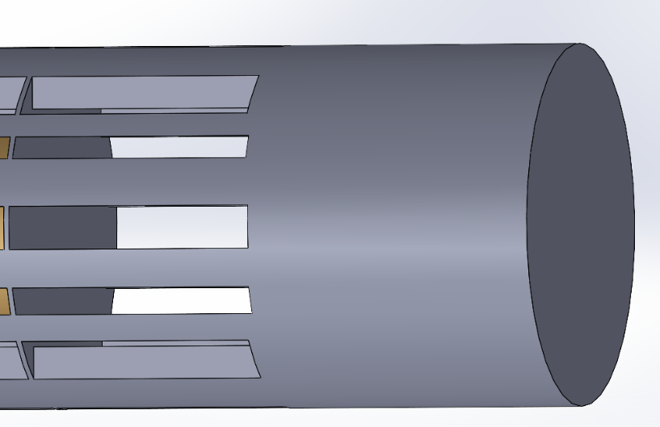
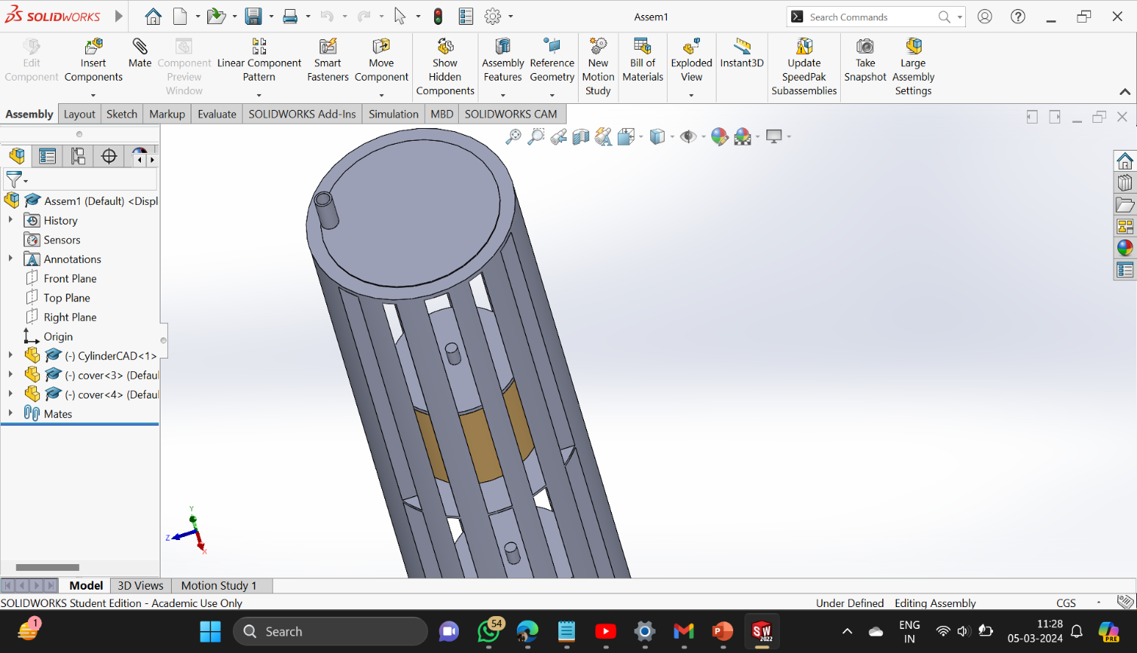
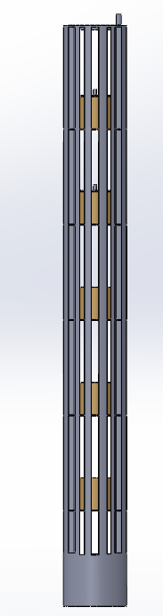
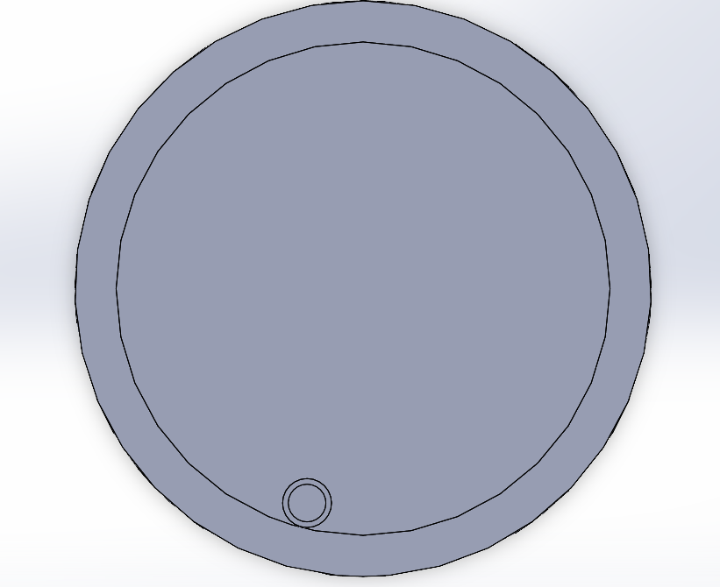
METHODOLOGY (COLLECTION CYLINDER)
Electronics Bay
SolidWorks CAD Model
Side View
Wiring Compartment

Slide 8
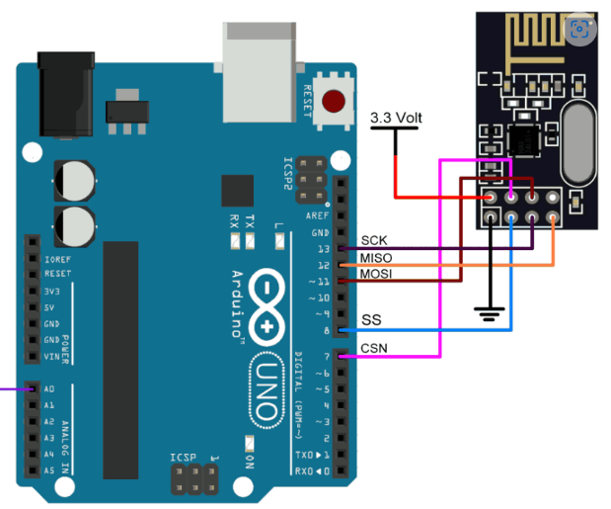
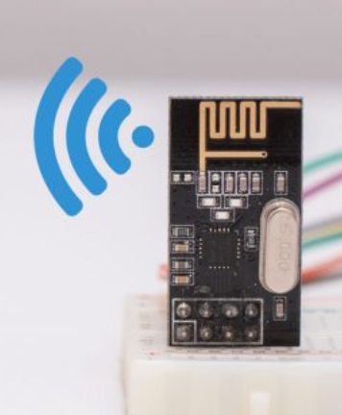
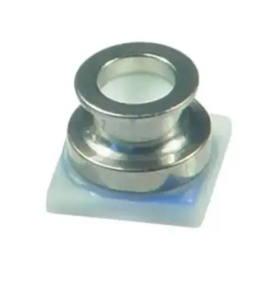
METHODOLOGY ( PRESSURE SENSOR + NRF)
The pressure sensor is attached to the bottom of collection cylinder.
It sends data which includes depth of water from surface.
This data is then wirelessly transmitted to receiving station.
NRF Module at receiver’s end
Sensor placed at bottom of Collection Cylinder

Slide 9
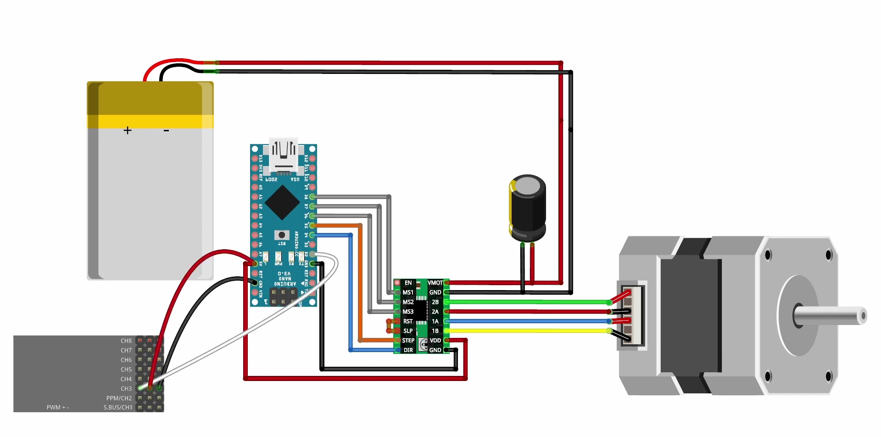
METHODOLOGY ( STEPPER MOTOR IMPLEMENTATION)
12V DC Supply
Arduino
100 µF Capacitor
A4988 Driver
Receiver
Stepper Motor

Slide 10
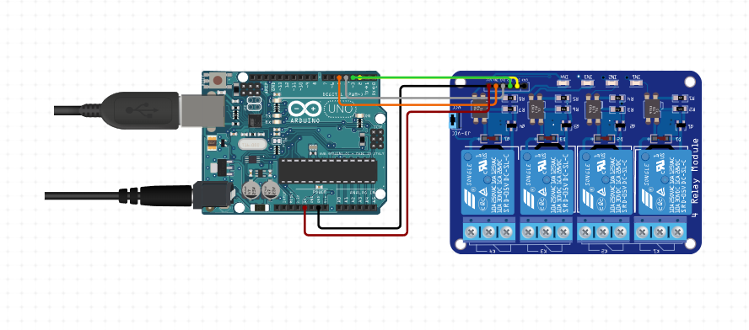
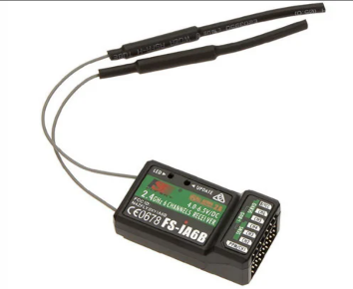
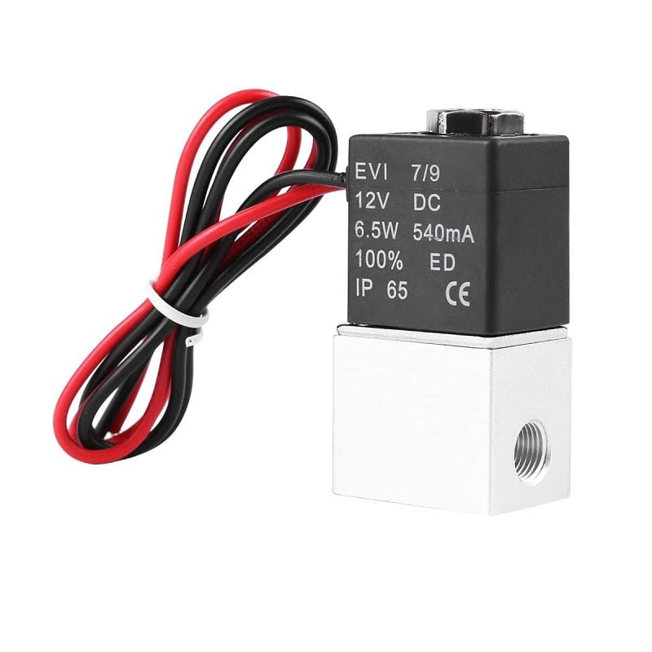
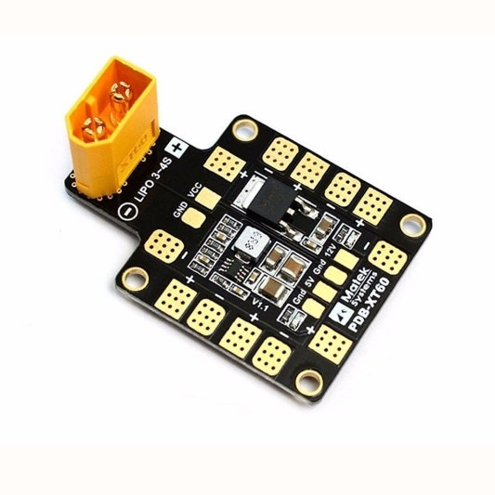
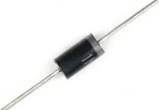
METHODOLOGY ( SWITCHING OF SOLENOID VALVE)
Arduino
Relay (4-channel)
Receiver
Snubber Diode
Power Distribution Board
12V Solenoid Valve

Slide 11
RESULTS AND DISCUSSION
We faced some issues of signal attenuation as cable lengths increased which we aim to mitigate in future scope.
We successfully made 2 arduino boards communicate wirelessly using an NRF module which facilitated 2-way communication. It has PA/LNA feature which stands for Power Amplification and Low Noise Amplification. It allows the module to be able to communicate even in high noise environments.
The NEMA17 7.2kg-cm Stepper Motor was used which proved to be appropriate for our application. The estimated weight of the cylinder is 6kg and with this stepper motor and driver combination, it will handle the load easily.
The current per phase was found out to be 1.7A which is well within the 2A limit put by the motor driver
An aluminium heat shield was installed on the driver to increase the current flow from 1A to 2A and worked perfectly. This avoided over-heating of the module.
A uni-directional 12V solenoid valve was used which proved to be extremely precise while in operation. It operates well under high pressure conditions (upto 1.2MPa). The response time is less than 50ms.

Slide 12
CONCLUSION AND FUTURE SCOPE
Successfully demonstrated the working prototype of the collection mechanism including the stepper motor and the solenoid valve.
We created a cheaper alternative and also made it remote-controlled which reduced a great deal of physical labour.
The circuitry is simple to execute. Hence, chances of failure are negligible.
In the future, we will create an algorithm where pre-determined depths will be fed before the process starts, and the collection will be done automatically when the vehicle reaches the point.
We will install a GPS module on-board the vehicle so that it could navigate to the selected collection point on its own without remotely controlling it.
In future, we will make the collection cylinders modular which will enable us to add or remove containers as per requirement.

Slide 13
REFERENCES
F. Fornai, F. Bartaloni, G. Ferri, A. Manzi, F. Ciuchi and C. Laschi, "An autonomous water monitoring and sampling system for small-sized ASV operations," 2012 Oceans, Hampton Roads, VA, USA, 2012, pp. 1-6, doi: 10.1109/OCEANS.2012.6405015.
Zhang Yanwu, Ryan John P., Kieft Brian, Hobson Brett W., McEwen Robert S., Godin Michael A., Harvey Julio B., Barone Benedetto, Bellingham James G., Birch James M., Scholin Christopher A., Chavez Francisco P., “Targeted Sampling by Autonomous Underwater Vehicles”
M. Zhang, D. Li, Y. He, J. Xiong, Z. Li and C. Xiong, "Autonomous Water Sampling System and Experiment Based on the Unmanned Surface Vehicle," 2021 IEEE International Conference on Unmanned Systems (ICUS), Beijing, China, 2021, pp. 608-613, doi: 10.1109/ICUS52573.2021.9641354.
Zhang, M., Li, D., Xiong, J. et al. Multi-dimensional water sampling unmanned surface vehicle development and application. Int. J. Dynam. Control 11, 3188–3208 (2023). https://doi.org/10.1007/s40435-023-01163-z
D. Madeo, A. Pozzebon, C. Mocenni and D. Bertoni, "A Low-Cost Unmanned Surface Vehicle for Pervasive Water Quality Monitoring," in IEEE Transactions on Instrumentation and Measurement, vol. 69, no. 4, pp. 1433-1444, April 2020, doi: 10.1109/TIM.2019.2963515.
Panetsos, Fotis, et al. "A motion control framework for autonomous water sampling and swing‐free transportation of a multirotor UAV with a cable‐suspended mechanism." Journal of Field Robotics 40.5 (2023): 1209-1230.

